Slide 1
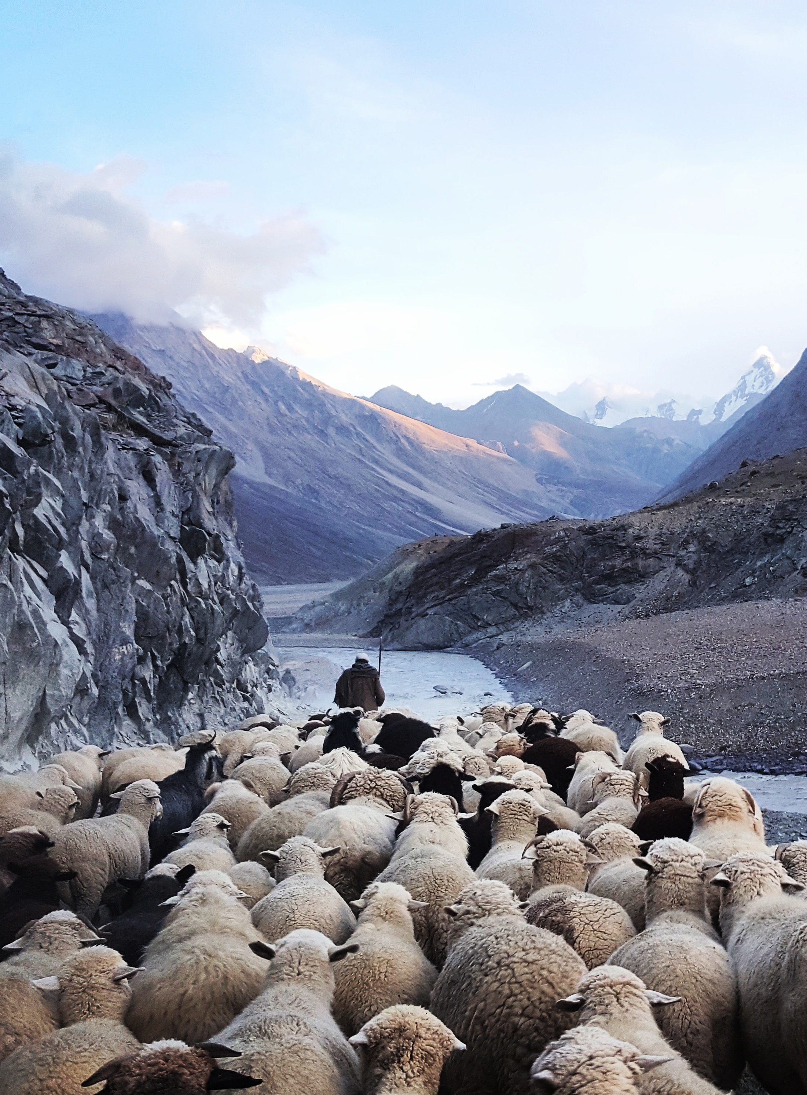


Digitanimal- Farm animal tracking and health monitoring
Presenting By Team The Debuggers:
Syed Saad- 21AT5A3508
Poola Vinay-20AT1A3560
Syed Noorullah- 21AT5A3507

Slide 2
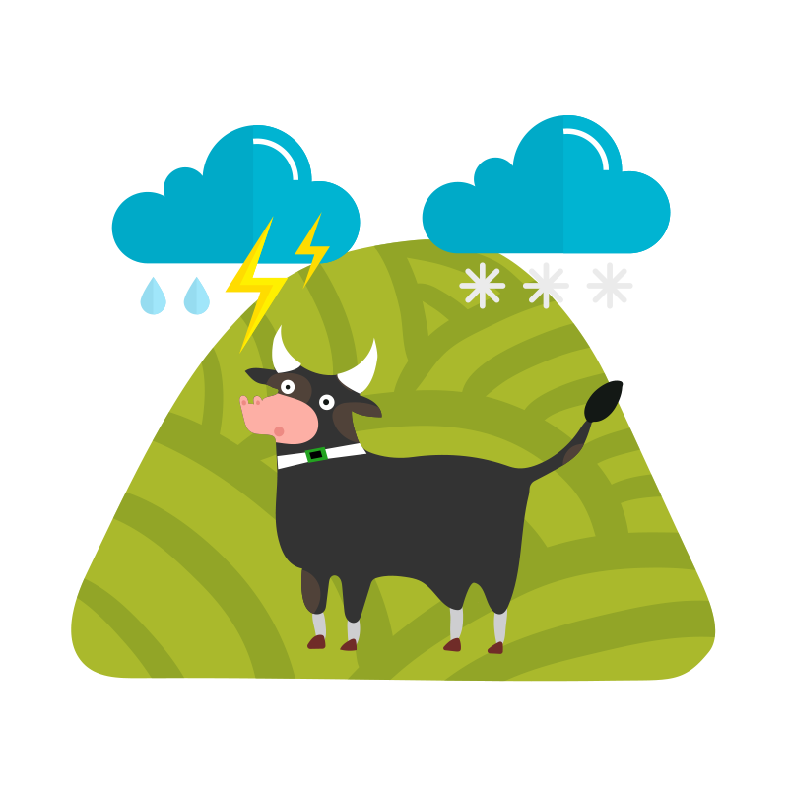
DIGITANimal
Saves Animals from mishap conditions and ensures the safety of the animal

Slide 3
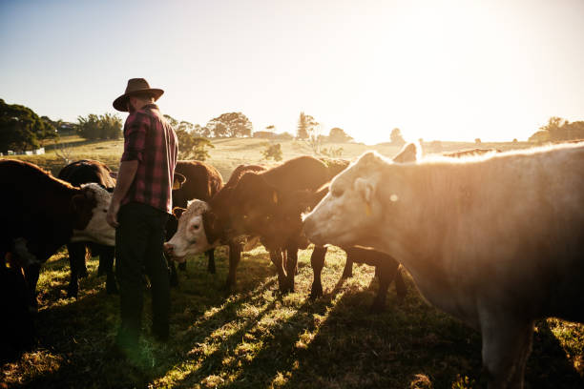
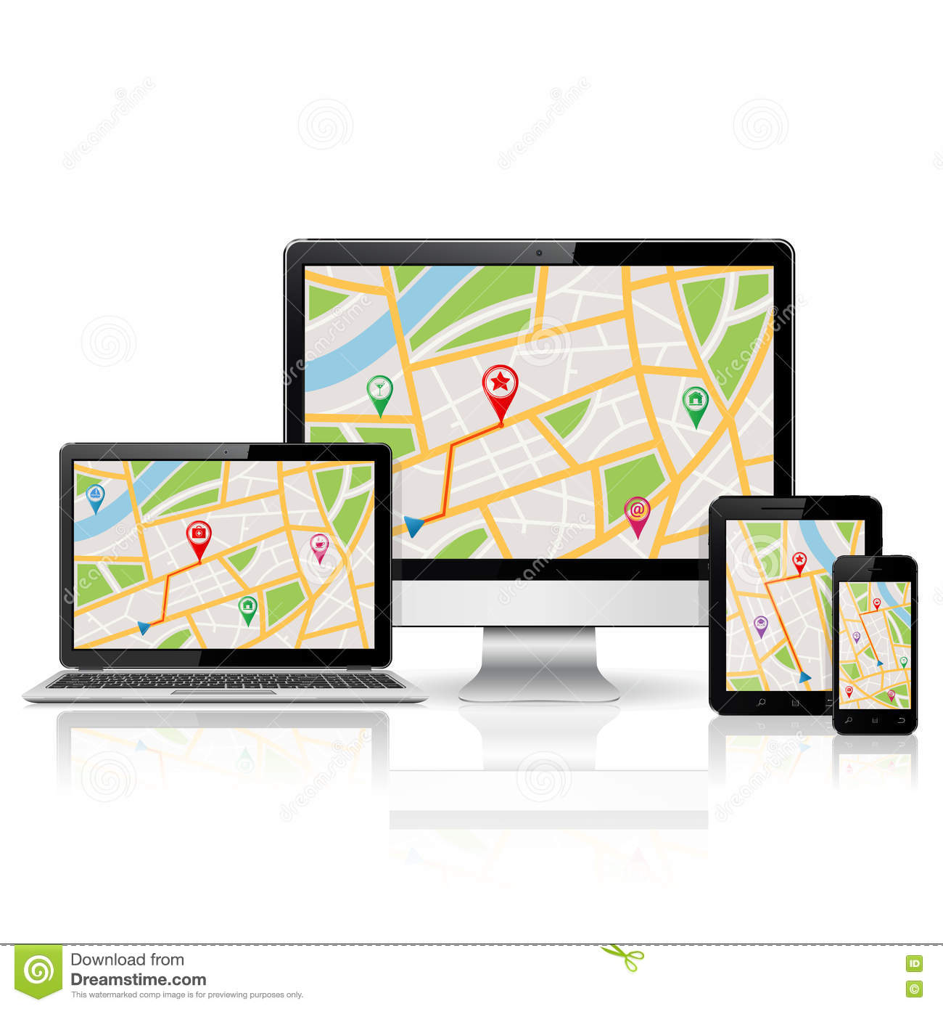
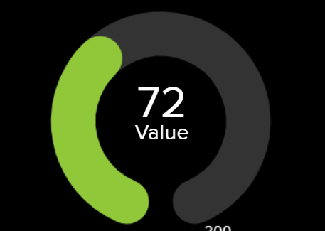
Agenda
Interfacing ESP32 with GPS module and Pulse sensor.
Tracking Animal Geographical location using GPS module.
Reading Pulses of the Animal using Pulse Sensor.
Uploading collected data from ESP32 to the Adafruit IO cloud.
Visualizing and monitoring the data through cloud.

Slide 4
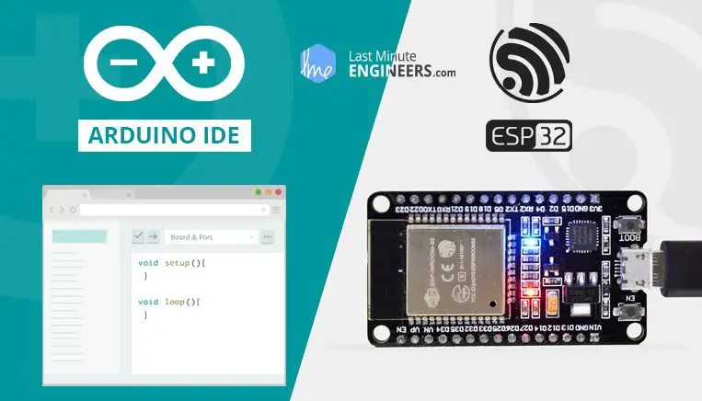

Softwares Required:
Arduino IDE
Adafruit IO Cloud

Slide 5
Libraries Required:
<WiFi.h>
<Adafruit_GPS.h>
<SoftwareSerial.h>
<Adafruit_MQTT.h>

Slide 6
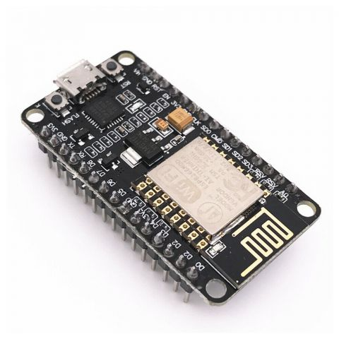
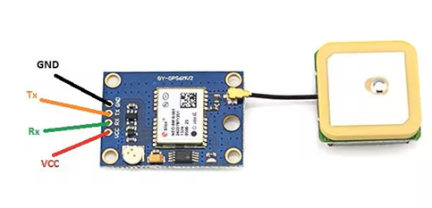
Components required:
ESP32 Microcontroller
The ESP32 is a low-cost, low-power microcontroller with integrated Wi-Fi and Bluetooth capabilities.
GPS NEO-6M Module
The global positioning system (GPS) is a network of satellites and receiving devices used to determine the location of something on Earth.

Slide 7
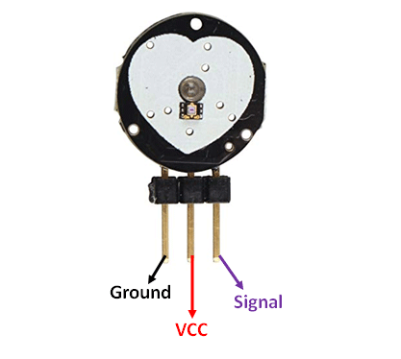
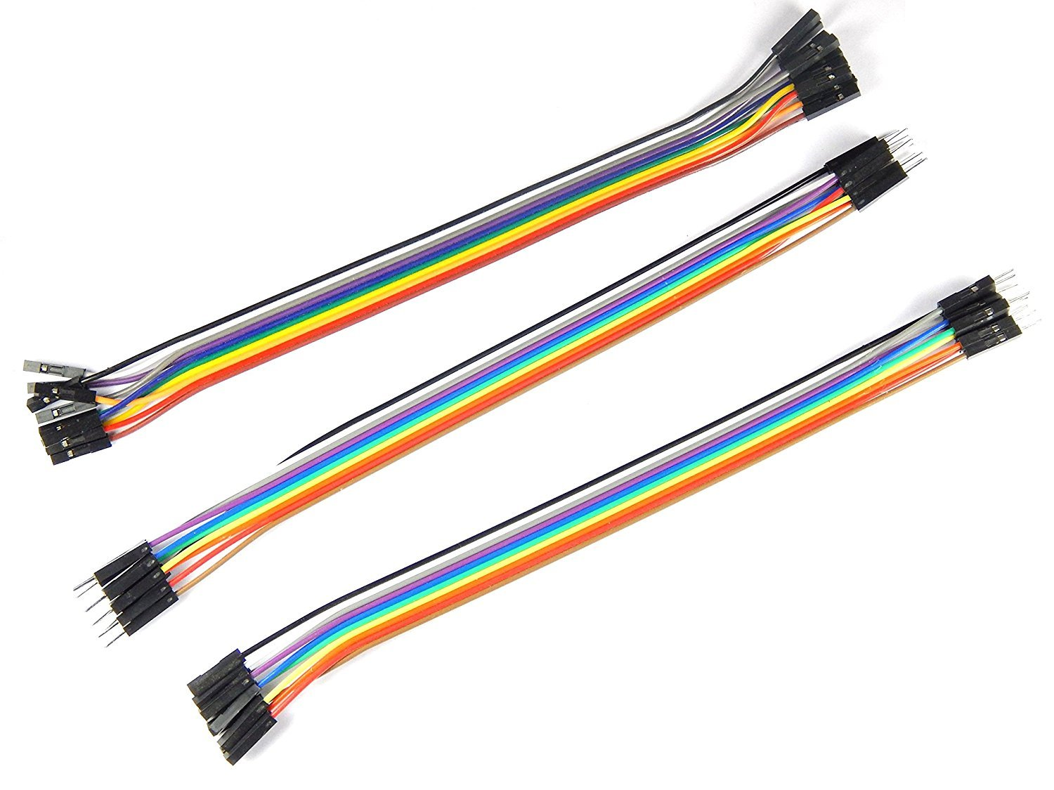
Components required:
Pulse Sensor
A plug-and-play sensor that is used to detect the heart rate data is known as a pulse sensor.
Jumper Wires
Jumper wires are electrical wires with connector pins at each end.

Slide 8





Block Diagram OF digitanimal
GPS Module
Animal
ESP32
Adafruit IO Cloud
Monitor
Pulse sensor

Slide 9
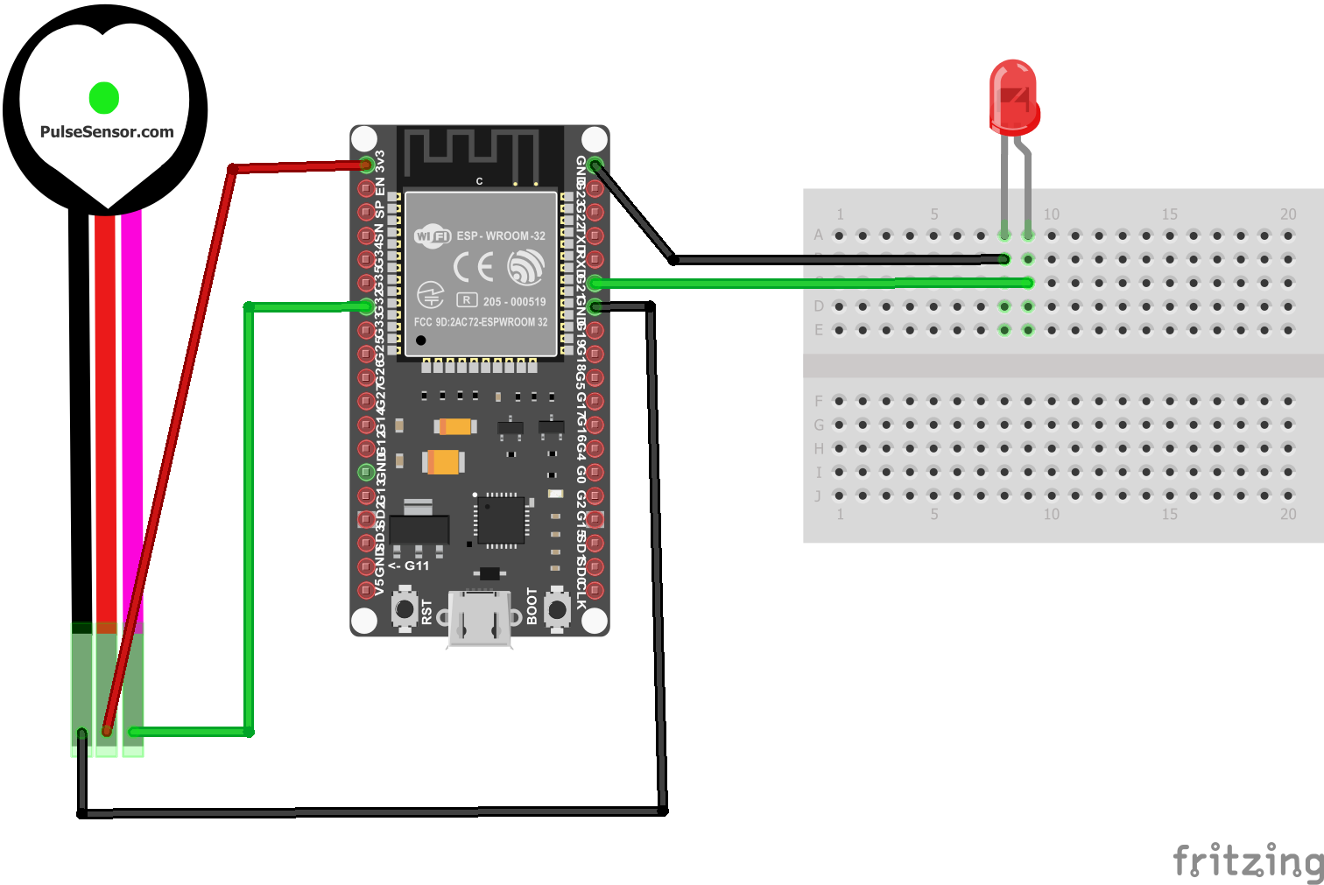
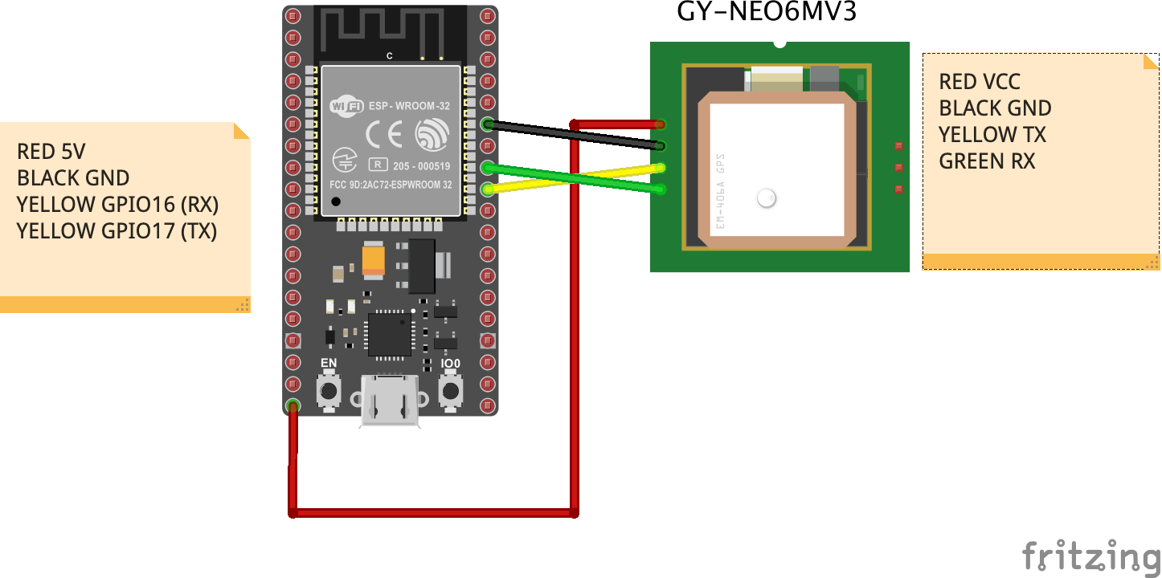
Circuit Diagram
Fig: GPS Module WITH ESP32
Fig: HEARTBEAT SENSOR WITH ESP32

Slide 10
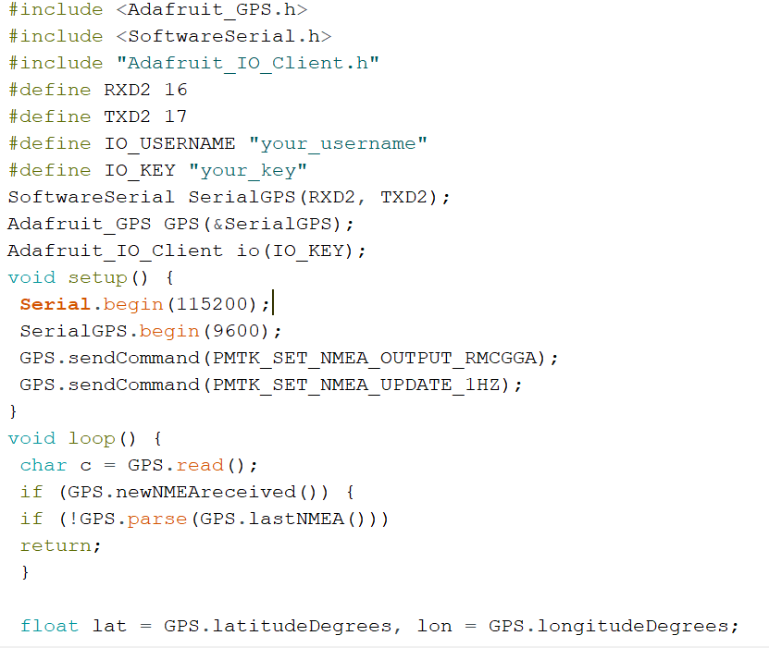
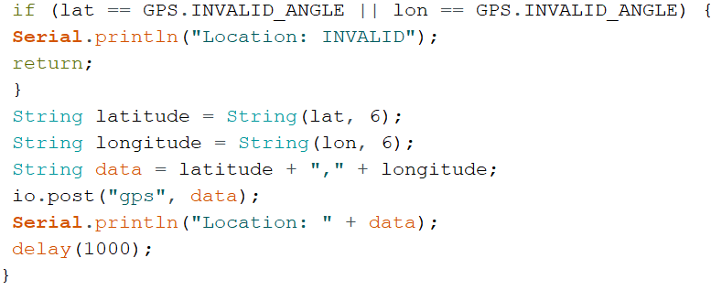
Code to interface GPS with esp32 and reading data

Slide 11
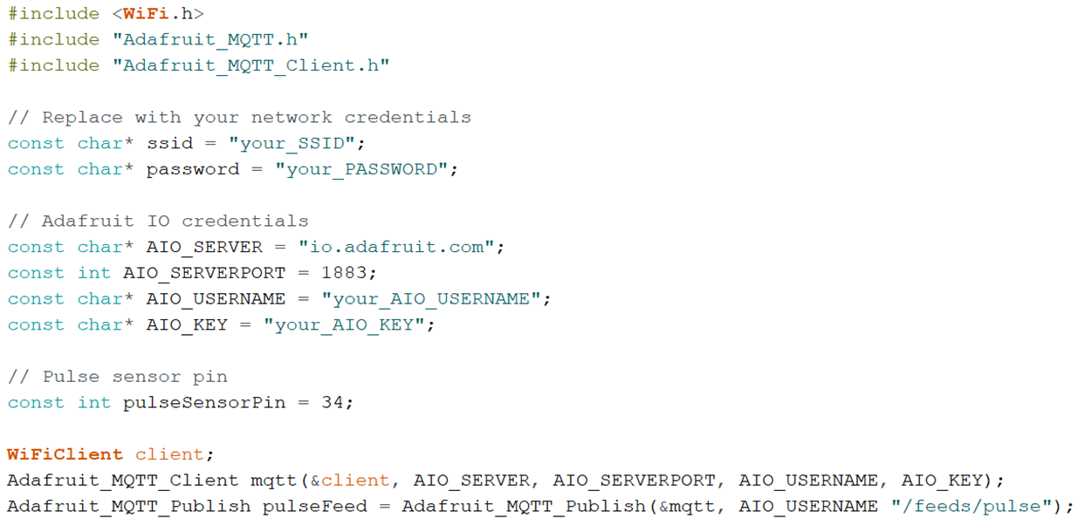
Code to interface Pulse Sensor with esp32

Slide 12
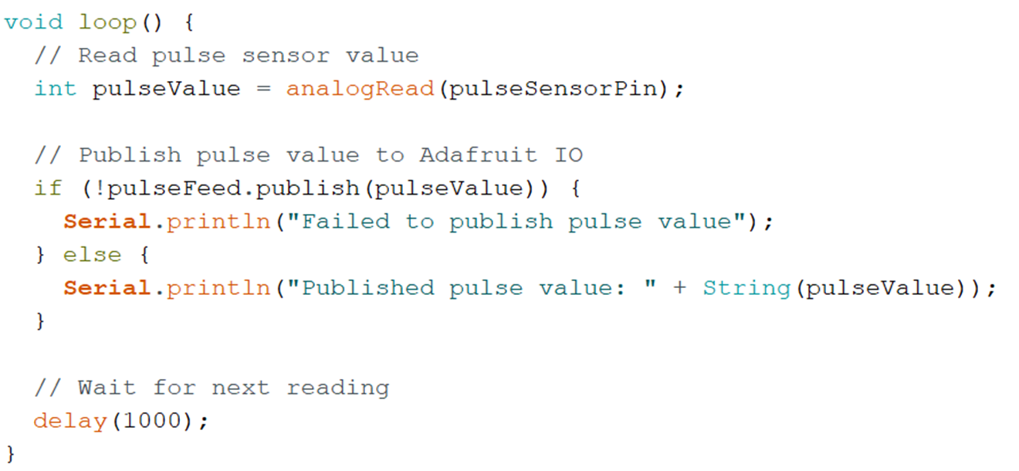
Code to interface Pulse Sensor with esp32 and reading data

Slide 13
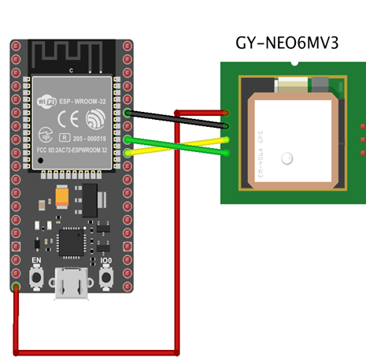
implementation
Connecting The circuit as per circuit diagram
Creating feed in adafruit io
Compiling and uploading the code in Arduino ide
Visiting Adafruit IO official website and creating an account.
Creating a feed and dashboard in Adafruit IO
Getting Adafruit IO Credentials
Writing code and logic in the Arduino IDE.
Compiling the code.
Verifying and uploading the code into the ESP32

Slide 14
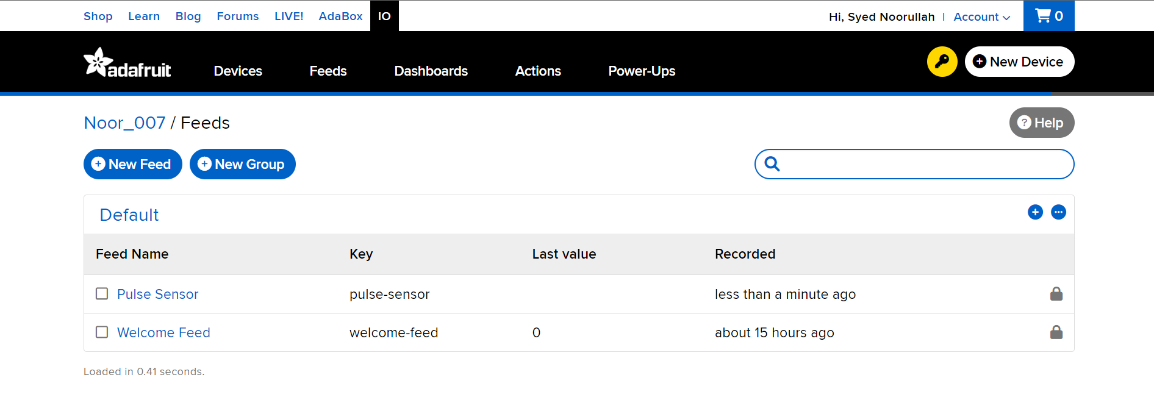
implementation
Creating feed in adafruit io

Slide 15
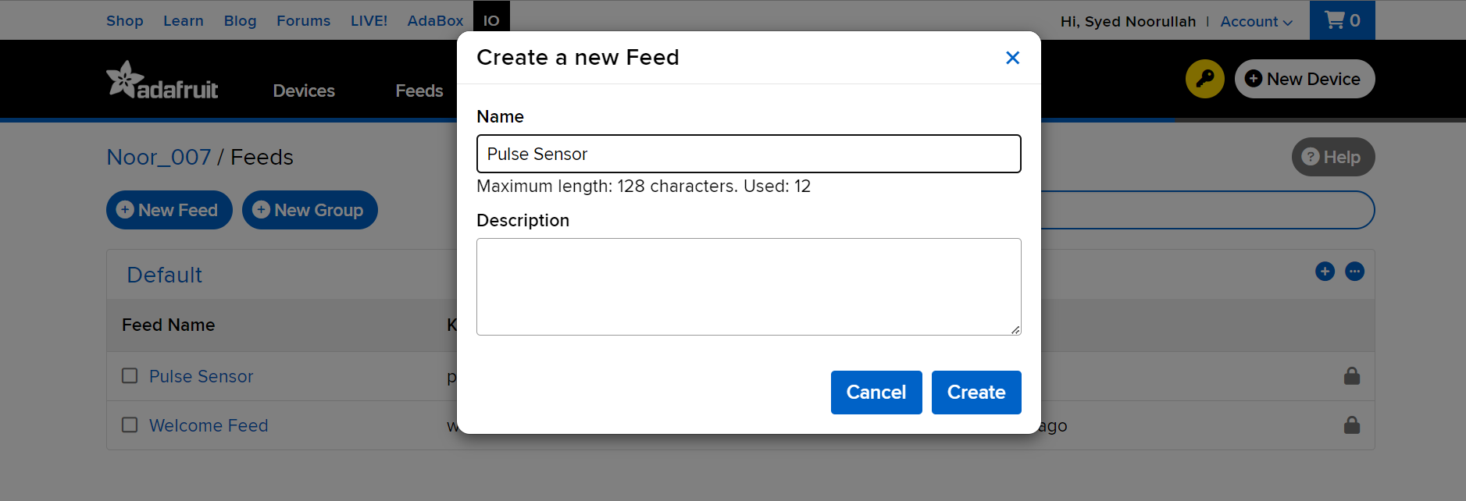
implementation
Creating feed in adafruit io

Slide 16
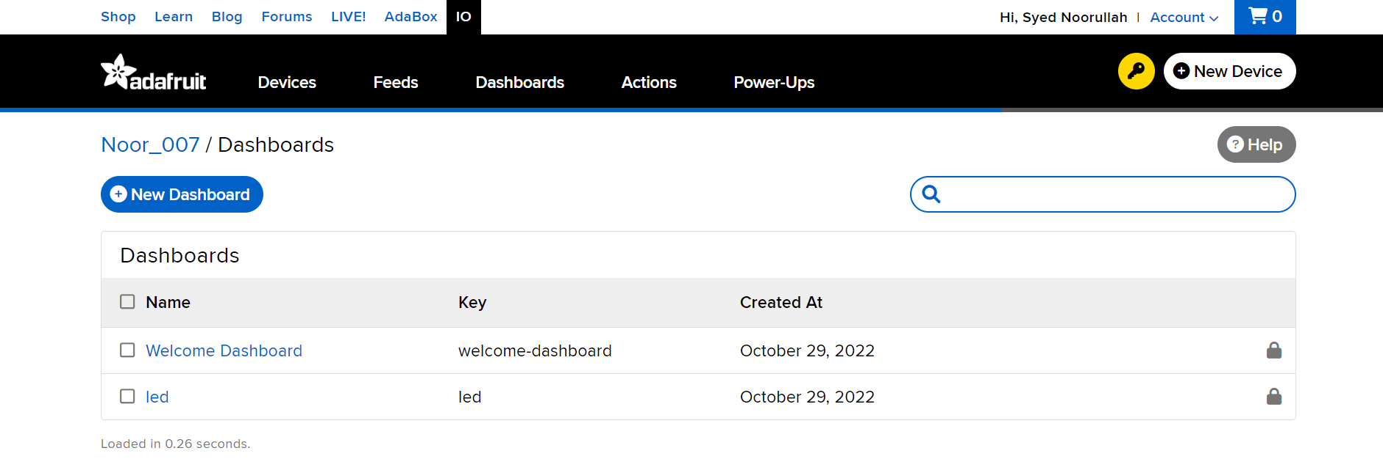
implementation
Creating Dashboard in adafruit io

Slide 17
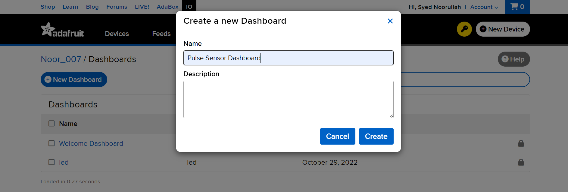
implementation
Creating Dashboard in adafruit io

Slide 18
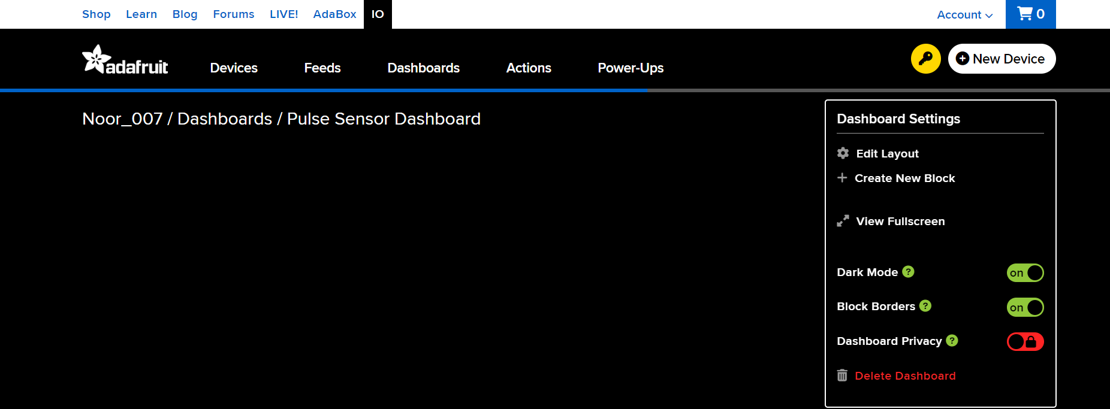
implementation
Creating Dashboard in adafruit io

Slide 19
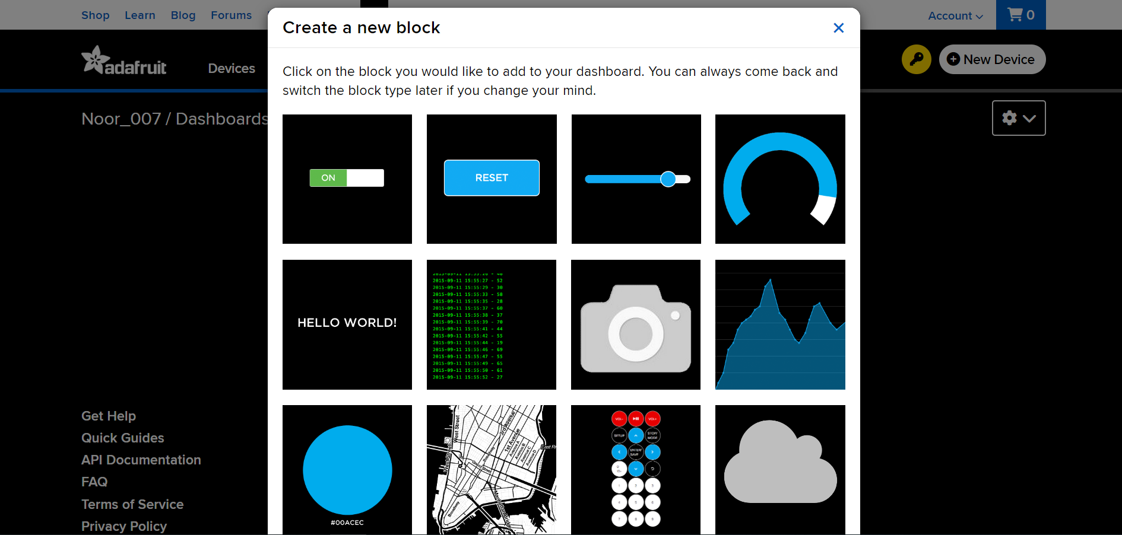
implementation
Creating Dashboard in adafruit io

Slide 20
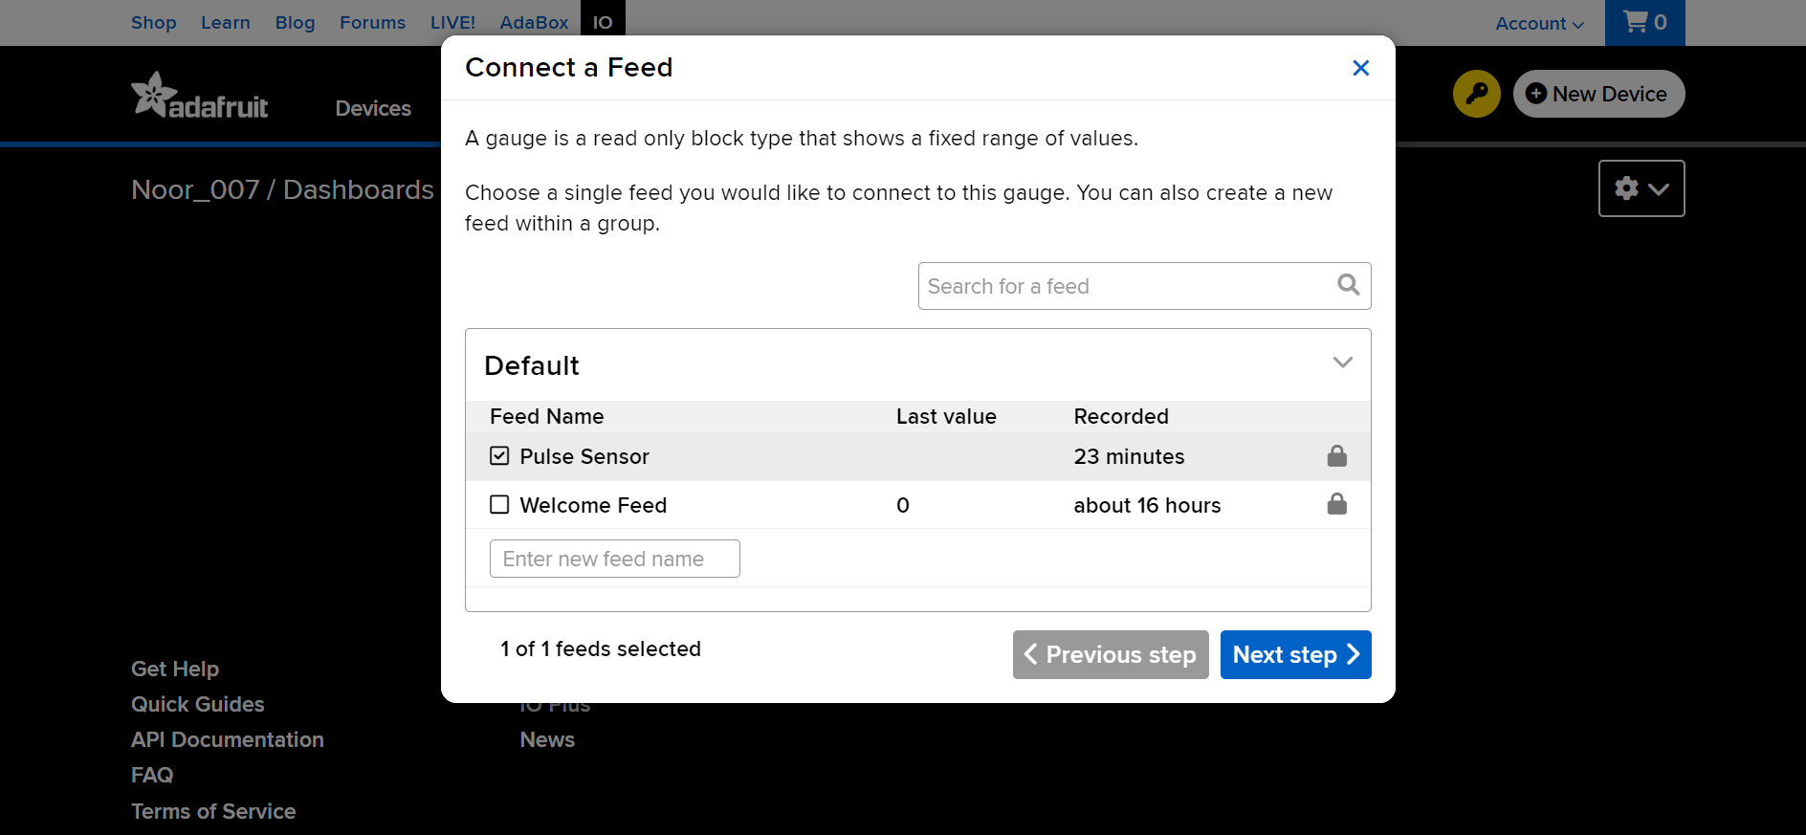
implementation
Creating Dashboard in adafruit io

Slide 21
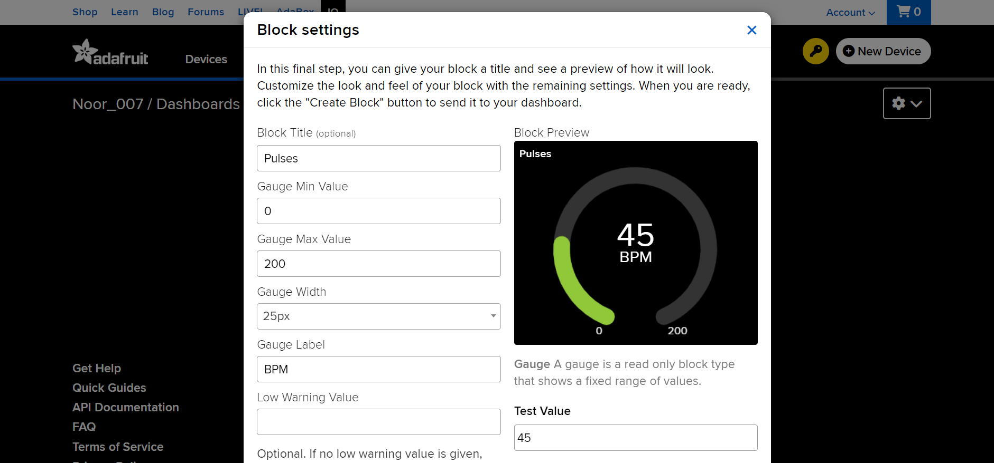
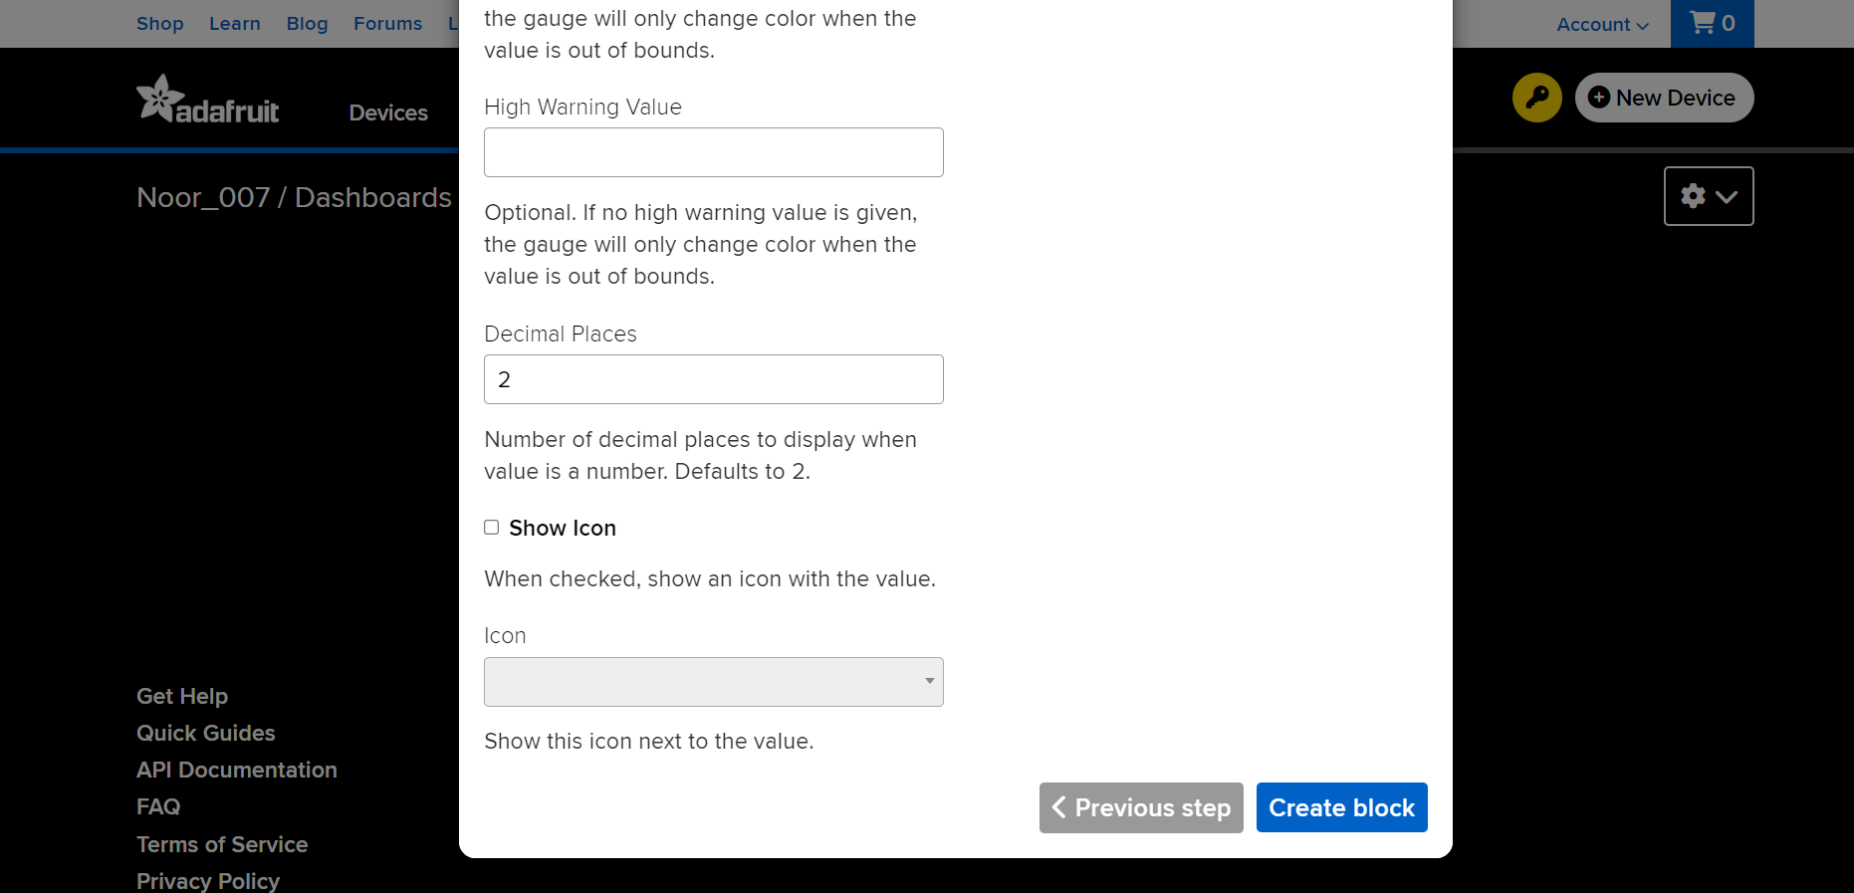
implementation
Creating Dashboard in adafruit io

Slide 22
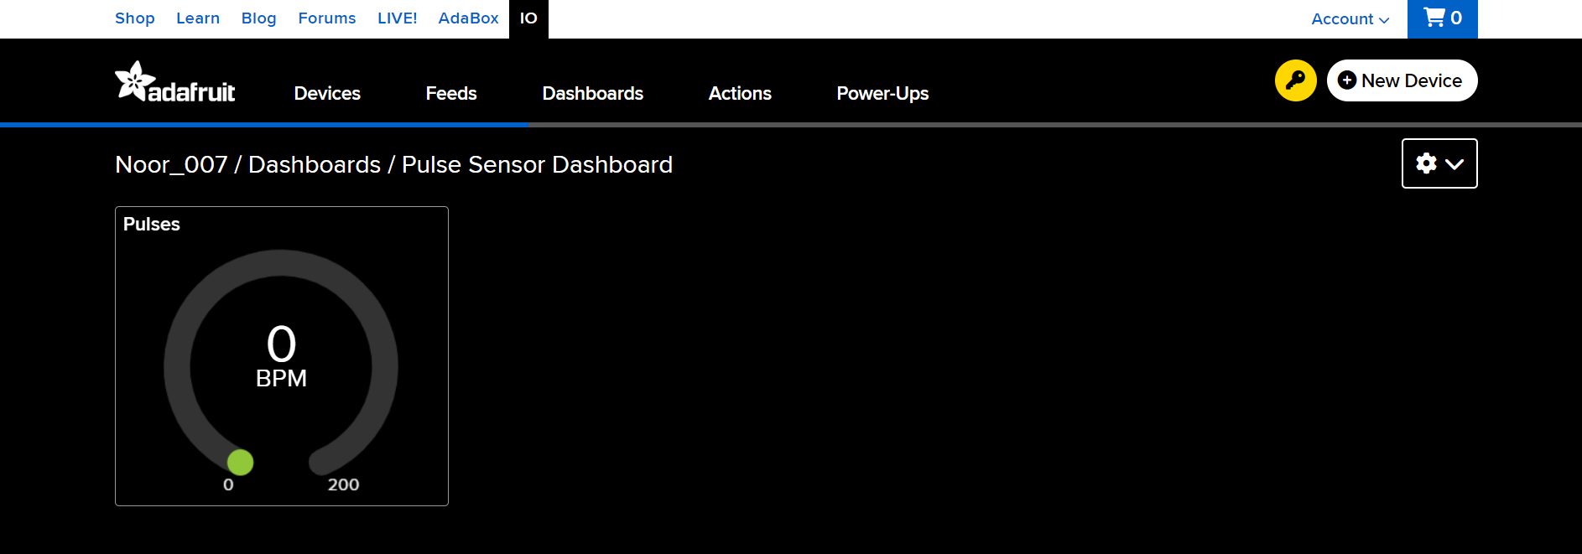
implementation
Creating Dashboard in adafruit io

Slide 23
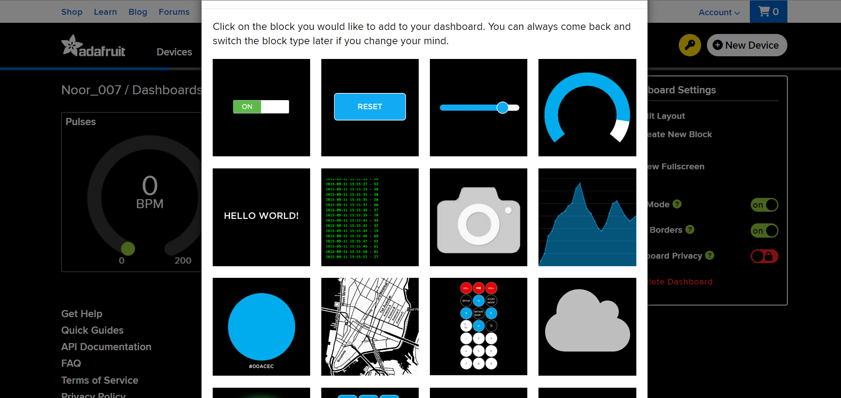
implementation
Creating Dashboard in adafruit io

Slide 24
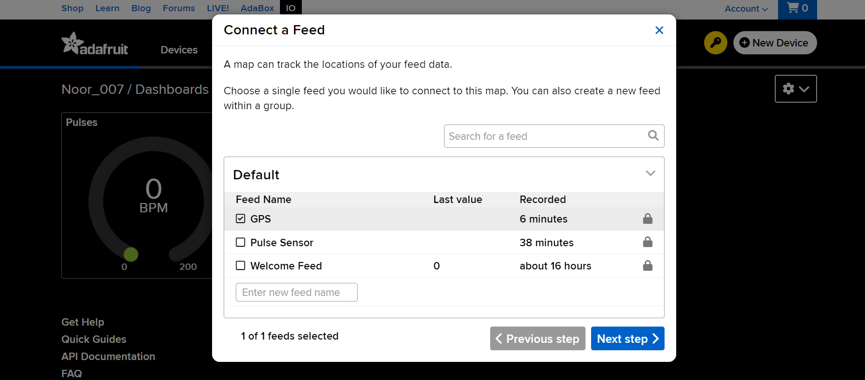
implementation
Creating Dashboard in adafruit io

Slide 25
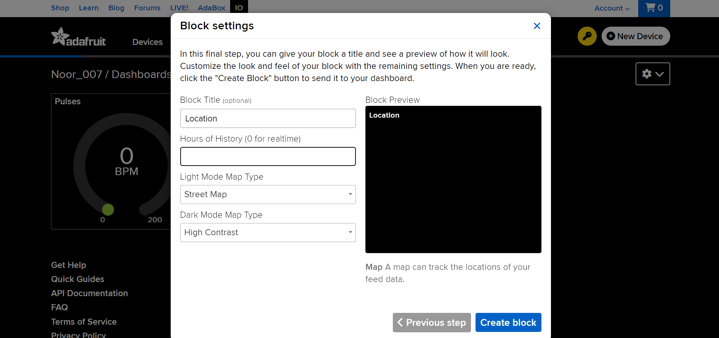
implementation
Creating Dashboard in adafruit io

Slide 26
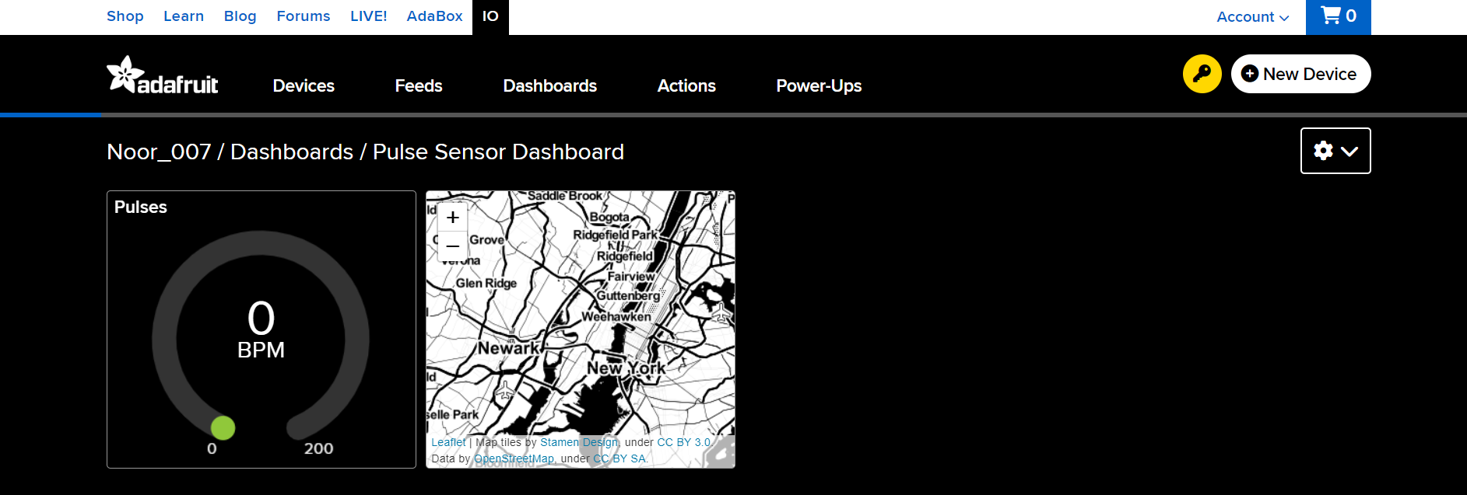
implementation
Creating Dashboard in adafruit io

Slide 27
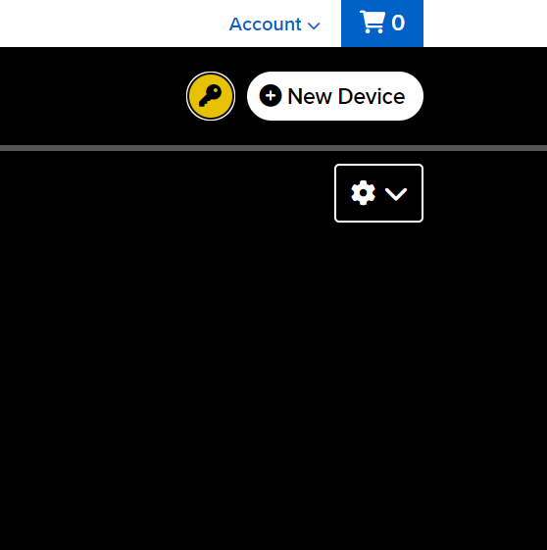
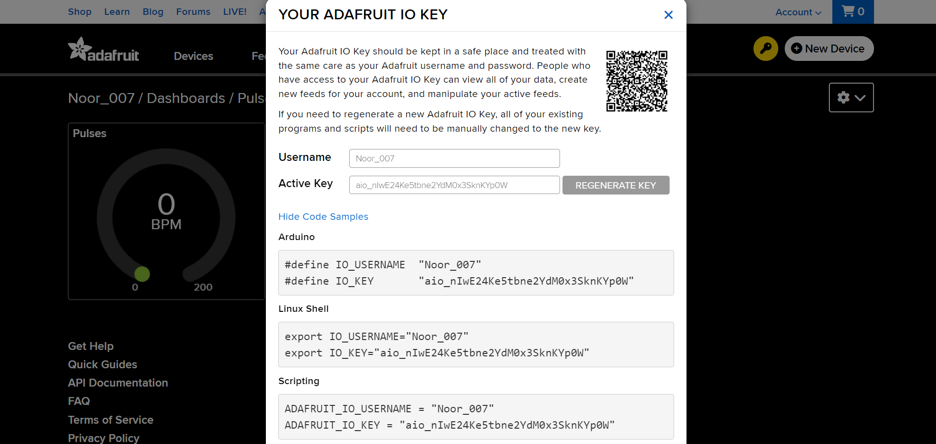
implementation
Knowing ADAfruit io credentials

Slide 28
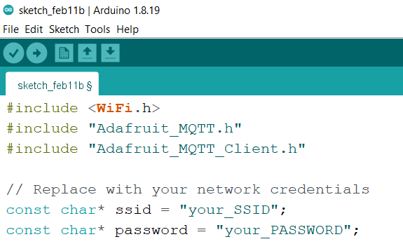

implementation
Compiling and uploading the code into ESp32

Slide 29
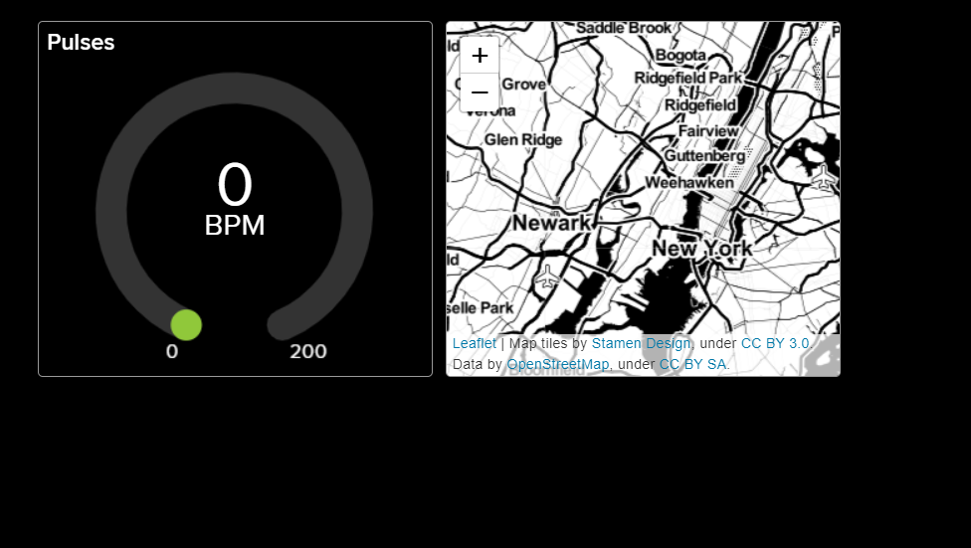
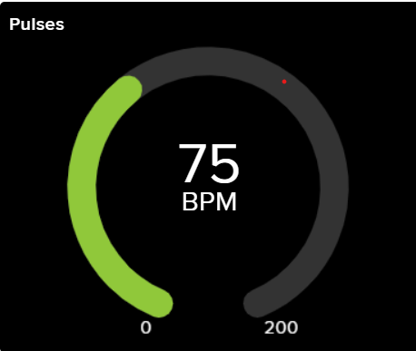
Monitoring Animals via dashboard

Slide 30
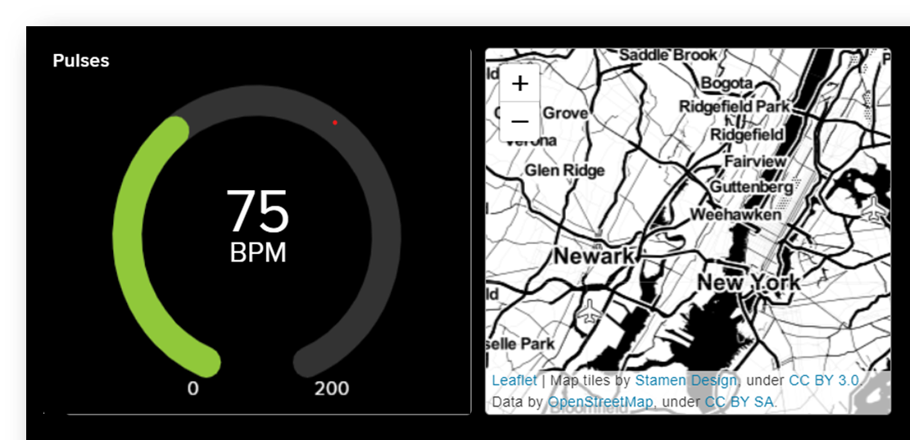
Conclusion
By using technologies like IoT and GPS, we came to monitor animal health and track animal location. Ensured security and health of the animal so that the herders improve both the quality of their herds and quality of their life.

Slide 31
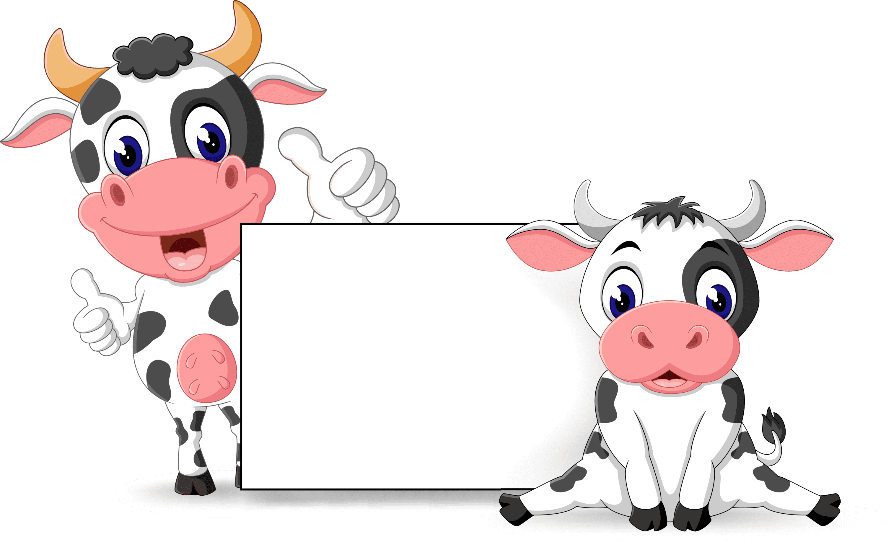

Thank You! We are happy to hear your feedback, we would come back stronger!

